Slide 1
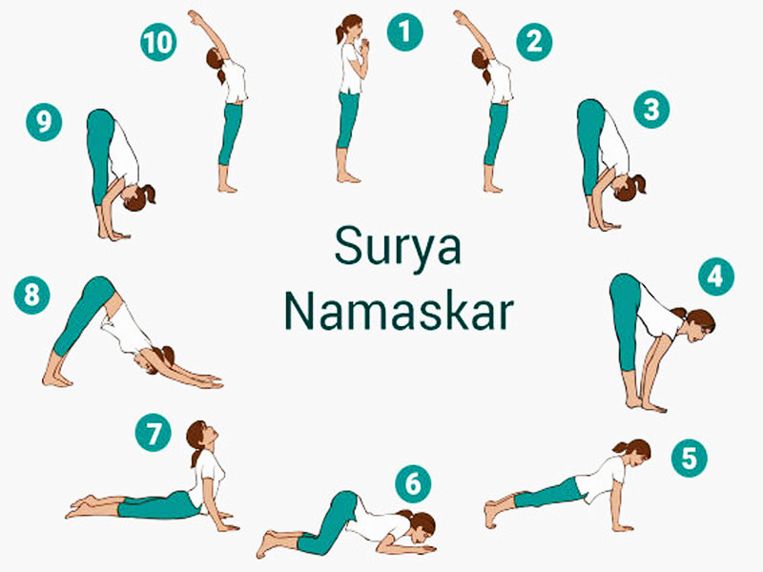

Capstone Project 21-22
Group Members:
1032180062 PB05 Atharva Ghodmare
1032180306 PB17 Adwait Mahadar
1032180414 PB30 Omkar Dutta
1032180429 PB32 Priyen Mangukiya
Project Guide:
Prof. Sheetal Girase

Slide 2
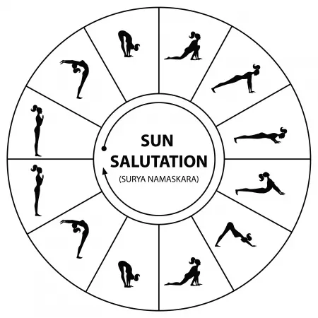
Motivation
The practice of Yoga is believed to have started with the very dawn of civilization, which is essentially a spiritual discipline based on an extremely subtle science, which focuses on bringing harmony between mind and body. It is an art and science of healthy living.
Sun Salutation or Salute to the Sun, is a practice in yoga as exercise incorporating a flow sequence of some twelve gracefully linked asanas.
While Sun Salutations have immense health and mental benefits, performing it incorrectly can have some undesirable effects on the body, especially in today’s online secluded world where people cannot physically attend yoga classes to learn precise yoga techniques.
Therefore to ensure accurate performance of sun salutations and gain its maximum benefits we aim to develop a model that would assist individuals correct their sun salutations.[1]
Notes:
There are many exercises which are repetitive in nature and are required to be done with perfection to derive maximum benefits.
Which demands proper training and assistance during the course of action. But, expecting an instructor at all times while performing

Slide 3
Feasibility
The PoseNet or MoveNet model can be used as a base model to which additional layers will be added in order to achieve the task of recognizing and correcting Sun Salutations. This model can be trained over the YogaVidCollected Dataset. This dataset is a collection for Yoga recognition that contains a total of 88 Videos, has a size of 1.1 GB. The Total duration is 1 hour 6 minutes and 5 seconds at 30 frames per second. If the dataset seems inefficacious for the task of sun salutation then we plan to prepare a novel dataset by recording the experts while performing sun salutations.

Slide 4
Feasibility
Software requirements:
We plan to use MoveNet, an ultra fast and accurate model that detects 17 key-points of a body, developed using TensorFlow.js at Google Research Lab. [2]
Hardware requirements:
We plan to use Google Collaboratory, with runtime type set to GPU, to train, assess, visualize and test our model for the task of recognition and correction of sun salutations.

Slide 5
Literature Review
Title | Author / Conference | Methodology | Comments
A Framework to assess Sun Salutation videos [3] | ICVGIP '16 18 December 2016 | HMM using STIP features | Due to unavailability of sophisticated architectures for the task of pose recognition this method was relatively time consuming and less accurate.
Yoga Pose Detection Using Deep Learning Techniques [4] | Narayanan, S. Sankara (ICICC) 2021 | Pre-trained weights were imported from TensorFlow using OpenPose. The data points are used to classify the postures and check if it was done correctly. | Addition of more features into the dataset improves the overall accuracy of the model.

Slide 6
Literature Review
Title | Conference | Methodology | Comments
Implementation of Machine Learning Technique for Identification of Yoga Poses [5] | 2020 IEEE 9th International Conference on Communication Systems and Network Technologies (CSNT) | The yoga pose is detected based on the angles extracted from the Skeleton joints of TF pose estimation algorithm. | Coordinates and the angles made by the joints can be extracted using OpenPose algorithm and Then these angles are used as features for machine learning models.
Classification of yoga pose using machine learning techniques [6] | J. Palanimeera, K. Ponmozhi | Classified the sun salutation yoga poses and machine learning technique that were used to get the correct results of each pose. | Out of the four machine learning models (Logistic regression , KNN, SVM, Naive Bayes ) KNN have better accuracy of 96%.

Slide 7
Research Gaps and Challenges
In the past, due to unavailability of sophisticated architectures like MobileNet (2019) and MoveNet (2021), the task of pose recognition this method was relatively time consuming and less accurate.
Earlier implementations yielded results that had low frames per second output (less than 10fps) which made these solutions more time consuming, taking away from the real-time feel.
Due to current pandemic situation people don't have any choice but to perform yoga at their homes, in such cases due to absence an expert trainer, many people end up performing incorrect yoga which may lead to injuries serious to one’s physique and brain.

Slide 8
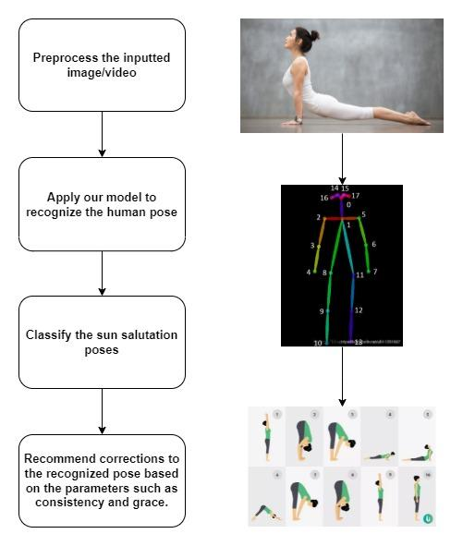
Problem Statement
To create a Deep Learning model that will detect the different yoga postures (asanas) of sun salutation (Surya Namaskar) and give corrections when needed.

Slide 9
Scope
Binary classification problem that will classify whether the pose of Sun salutation performed by an individual in a video is correct or wrong.
If the individual is performing a certain pose in an incorrect manner, then a feedback will be provided indicating the correction in the pose.

Slide 10
References
[1] https://en.wikipedia.org/wiki/Sun_Salutation
[2] https://www.tensorflow.org/hub/tutorials/movenet
[3] Hiteshi Jain and Gaurav Harit. 2016. A framework to assess Sun salutation videos. In Proceedings of the Tenth Indian Conference on Computer Vision, Graphics and Image Processing (ICVGIP '16). Association for Computing Machinery, New York, NY, USA, Article 29, 1–8. DOI:https://doi.org/10.1145/3009977.3010045
[4] Narayanan, S. Sankara and Misra, Devendra Kumar and Arora, Kartik and Rai, Harsh, Yoga Pose Detection Using Deep Learning Techniques (May 10, 2021). Proceedings of the International Conference on Innovative Computing & Communication (ICICC) 2021, Available at SSRN: https://ssrn.com/abstract=3842656 or http://dx.doi.org/10.2139/ssrn.3842656

Slide 11
References
[5] Y. Agrawal, Y. Shah and A. Sharma, "Implementation of Machine Learning Technique for Identification of Yoga Poses," 2020 IEEE 9th International Conference on Communication Systems and Network Technologies (CSNT), 2020, pp. 40-43, doi: 10.1109/CSNT48778.2020.9115758.
[6] J. Palanimeera, K. Ponmozhi,Classification of yoga pose using machine learning techniques,Materials Today: Proceedings,Volume 37, Part 2,2021,Pages 2930-2933,ISSN 2214-7853,https://doi.org/10.1016/j.matpr.2020.08.700

Slide 12
Thank You !

